Slide 1
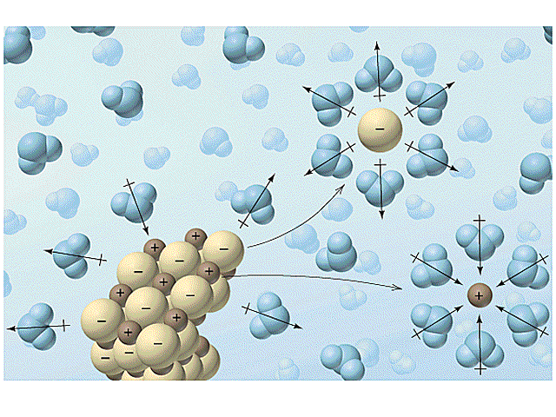

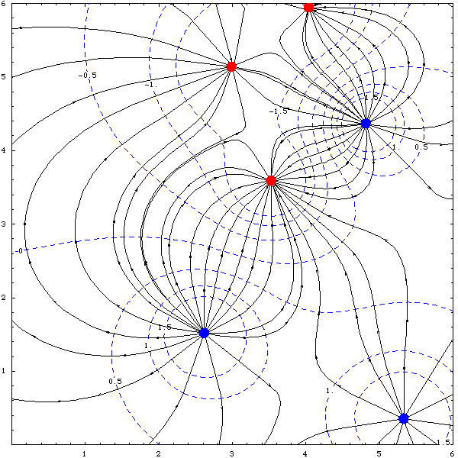

CHEM 450/450G
Dr. M. J. Nee
Lecture II-8
Electrolyte solutions and ionic strength
Plan for Today:
Electrolyte solutions
Thermodynamics of Solubility
Ionic Strength
Debye-Hückel theory
Effects of ions in solution

Slide 2
Electrolytes in solution
Electrolytes have a formula unit, not a molecular formula: when you have 100 Na⁺ and 100 Cl⁻ in a crystal, you break the equivalent of 100 NaCl bonds.
Cannot have a solution of cations, or a solution of anions: the solution is both together... and neutral.
Dissociation is favored when entropic gain outweighs enthalpic input to “break” bond

Slide 3
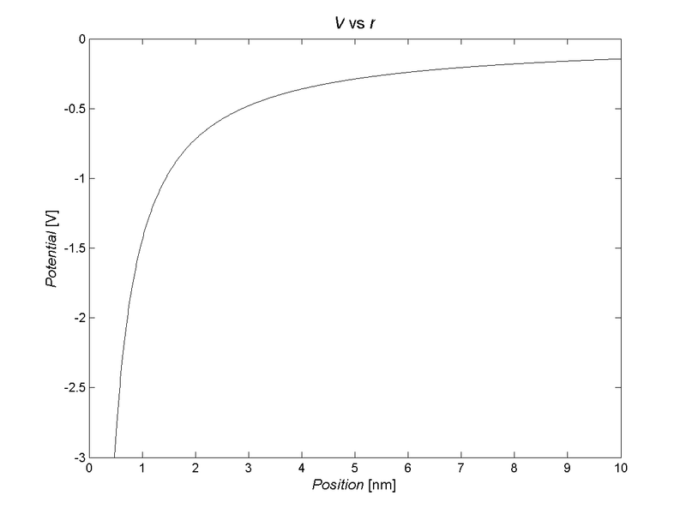
Electric field (potential) from a point charge
For a single point charge:
Force between two charges:

Slide 4
Thermodynamics of dissociation
All thermodynamic state functions (ΔG°_{f} , ΔH°_{f,} S°) are referenced to H⁺ = 0 for ions.
Gibbs Energy for dissociation is defined in the same way as before, using a reaction like:
If ΔG_{R} < 0, the reaction is spontaneous, so the electrolyte is “soluble”

Slide 5
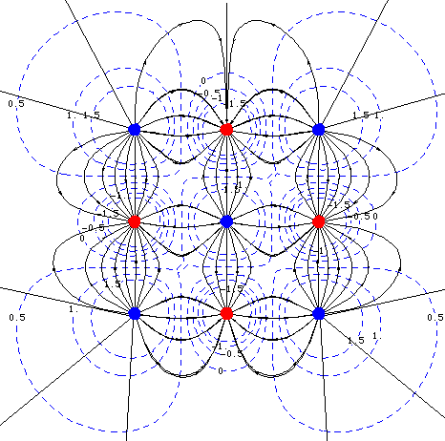
What is the effect of ionic field?
Compared to non-electrolytes, solute-solute interactions are dominated by long-range electrostatics!

Slide 6
Chemical potential of electrolyte solutions
We define a mean ionic chemical potential, μ±, for the solute as:
We must use this mean ionic μ because we cannot experimentally get μ for the individual ions (no solution of just cations!)

Slide 7
Activities of electrolyte solutions
Similarly, we identify a mean ionic activity, a±:
here, the stoichiometric coefficients require some care:
υ₊ Cation
υ₋ Anion
υ Formula unit ( )

Slide 8
Mean ionic molality
Ionic molalities are related to activities by the activity coefficients. The mean ionic molality is the geometric mean of the ionic molalities of the cation and anion:
So that the relationship between a± and m± is:

Slide 9
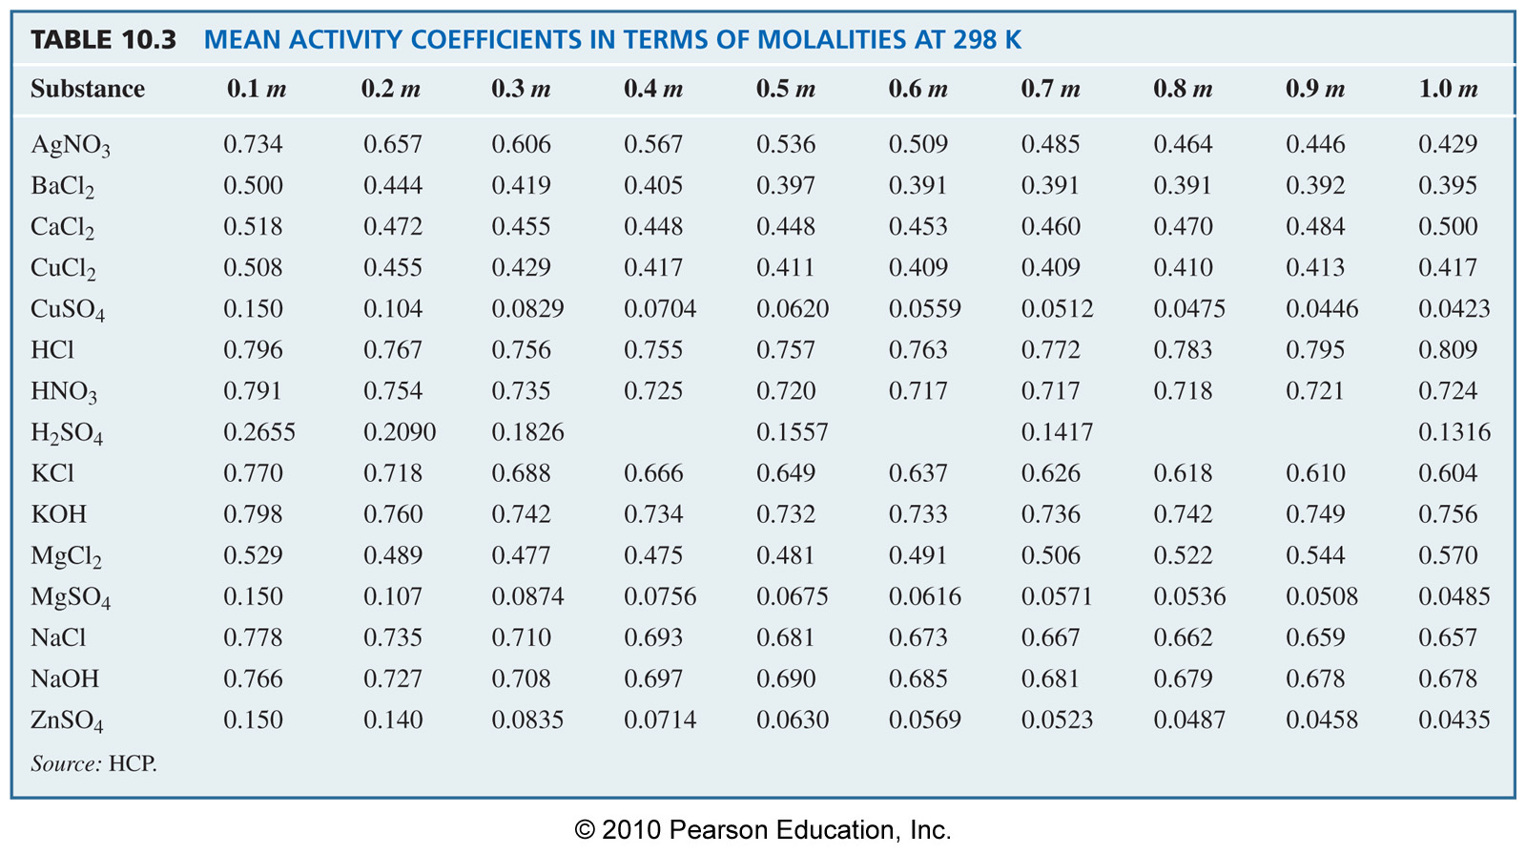
Mean activity coefficients: high molality

Slide 10
Ionic Strength measures influence of field
Note: here, i is each ion. Thus, m_{i} accounts for the number of ions that each formula unit dissociates into.
Implications:
For a 1:1 electrolyte, I = m
As z increases, I increases exponentially.
Increasing charge per ion dominates over increasing number of ions.

Slide 11
Debye-Hückel Theory
Uses electrostatics to correlate ionic strength to mean ionic activity coefficient:
Where, for aqueous solutions at T = 298.15 K,
This is strictly valid only for dilute solutions

Slide 12
Equilibrium in electrolyte solutions
Just as for regular solutions. However, solute-solute interactions are dominated by electrostatics in electrolyte solutions:
For dilute solutions, a± comes from D-H theory. Otherwise, use the table based on the molality of the electrolyte.

Slide 13
Dependence on electrolyte concentrations
Debye-Hückel theory applies low concentration (I < 0.1)
Calculate γ and a using D-H
Use the TOTAL ionic strength
Above I = 0.1, use Table 10.3 (appendix).
In both cases, ionic strength can arise from multiple sources, but it is additive!

Slide 14
Iterative Equilibrium Calculations
For reactions that produce electrolytes (like dissociation), there is a feedback loop:
Calculate concentration from K_{C}
Calculate ionic strength based on concentration
Re-calculate equilibrium based on activity
Calculate activity based on ionic strength

Slide 15
An example: dissociation of an acid
pH = -log₁₀[H⁺]
pK_{a} = -log₁₀K_{a}
Compare pH of 0.1 M aspartic acid (pK_{a} = 4.0) (a) in pure water and (b) in the presence of a solution which is 10 mM in potassium sulfate.

Slide 16
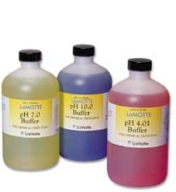
Henderson-Hasselbach equation
We use equilibrium to show that adding the conjugate base to a solution of weak acid will “buffer” the solution against change in pH.

Slide 17
Electrolytes and Buffers
Account for ionic strength in acid-base dissociation using the Debye-Hückel theory, and using a_{H+} instead of [H⁺].
For weak acids, the acid alone does not contribute much to the ionic strength, but a buffer certainly can:
If pK_{a} = 4.76, 0.1M HA, [H⁺] = 0.00132, I = 0.00132
pH adjustment is only 0.018

Slide 18
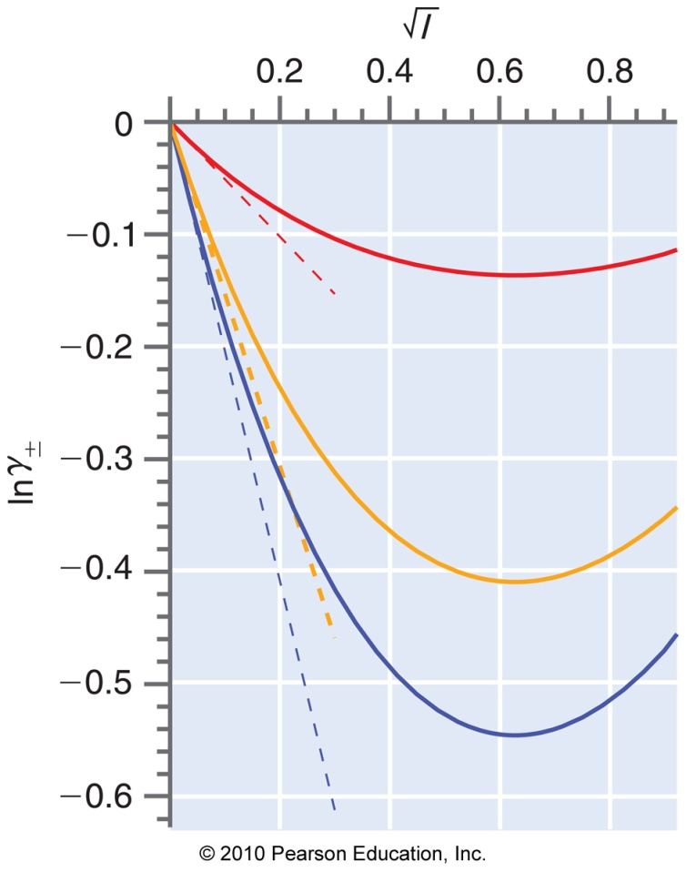
The Davies Equation
An example of an empirical model: It seems to produce real behavior more at higher ionic strength.

Slide 19
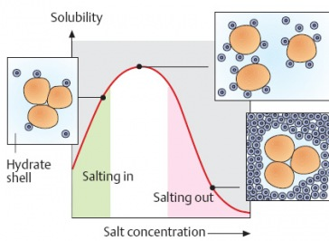
Salting in/Salting Out
The Davies model predicts first an increase (salting in), then a decrease (salting out) in solubilty with ionic strength. The two effects arise from different phenomena.

Slide 20
That’s it for Unit II. We review on Thursday, and have Exam 2 next Tuesday. Email if you have questions!
HW 7 is due 10/29, and will include both this material and the real solutions/activities content.

